Slide 1

SMART TAGS
Yash Suri
2019B311175
2nd Year / Electronics & Comm. Engineering

Slide 2
Table of contents
S.NO. | TOPIC | PAGE NO.
1 | Introduction of the project | 3
2 | Brief Technical Aspects | 4
3 | Relevance to Indian Navy | 5
4 | Prospective Implementation | 6
5 | Conclusion | 7

Slide 3
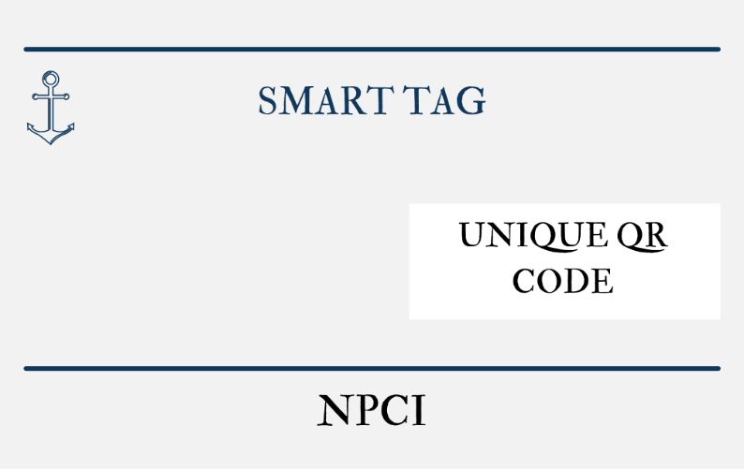
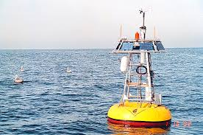
Introduction of the project
Smart Tag will be RFID tag that will be used as a security system similar to the anti-theft tags used to secure products and will also have the ability to collect taxes from the vessels similar to the FASTag that is used to make the process of toll collection easy.
Combining the abilities of both the tags, Smart Tag can easily help in identifying the friendly and non-friendly vessels which will also reduce the risk of any threats from the Indian Waters. The Buoys that will act as electromagnetic scanners will never switch off making it more difficult for any vessel to cross the borders without being noticed by the Indian Coast Guards. Adding to its security measures the system will not shut down without a password or a code. It will make the system more secure and will also reduce the risk of being attacked by hackers.

Slide 4
Brief Technical Aspect
The RFID tags are of three types namely, Passive Tags, Active Tags, and Semi-Passive Tags –
Passive RFID tags do not have a battery. They use power from the readers that are the active elements in their case to transmit electromagnetic waves that induce a current in the tag’s antenna. The coded message is then sent back to the reader at a discrete frequency.
Active RFID tags are battery-powered sensors that continuously accumulate and broadcast data to a receiving device. Active RFID Tags comprise three systems namely, a tag, a reader, and an antenna.
Semi - Passive RFID tags are battery-operated passive tags. They are similar to passive tags in terms of Ease of manufacture and in size but have the ability like the Active tags of transmitting the data over larger distances.

Slide 5
Relevance to Indian Navy
The attacks similar to the one in Mumbai on 26th November,2011 can be prevented.
The Exclusive Economic Zone can act as a buffer zone as it extends up to 200 nautical miles off the Indian coast.
Growing agitations with China in the Indian Ocean and in the Pangong Tso lake in Ladakh.
Illegal trade between India and Sri Lanka should be ceased.

Slide 6
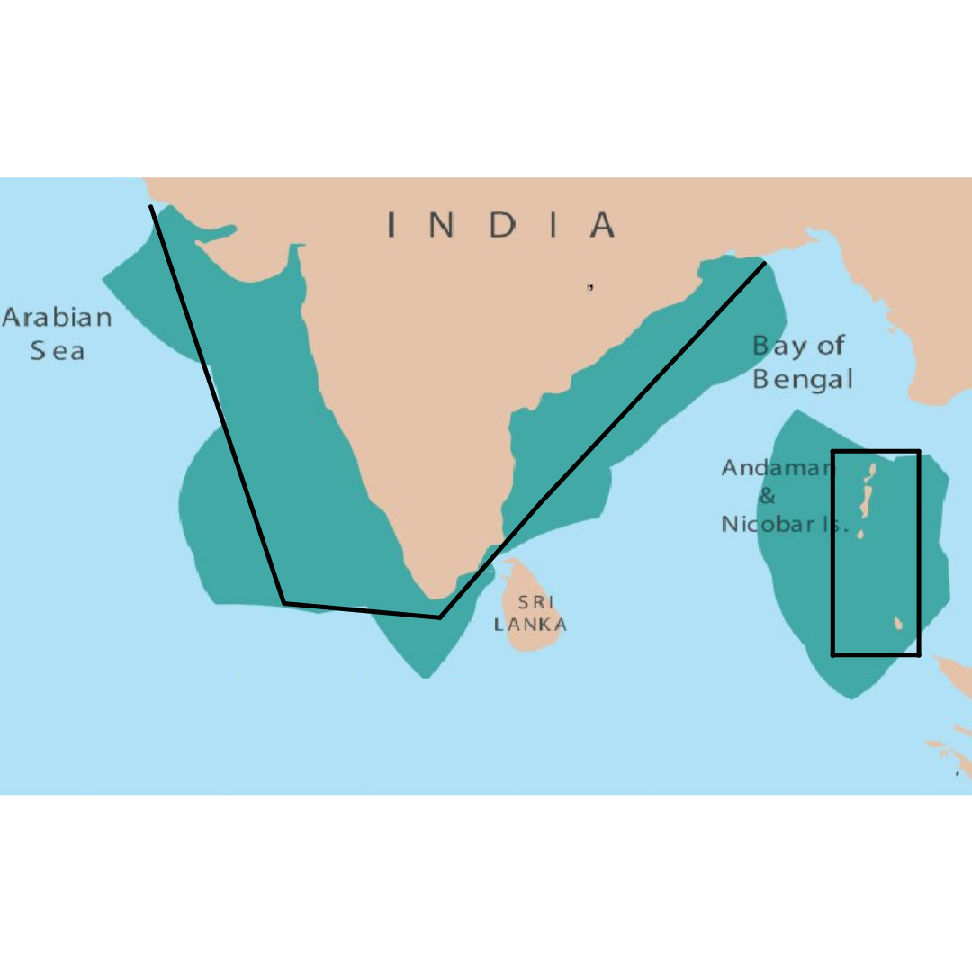
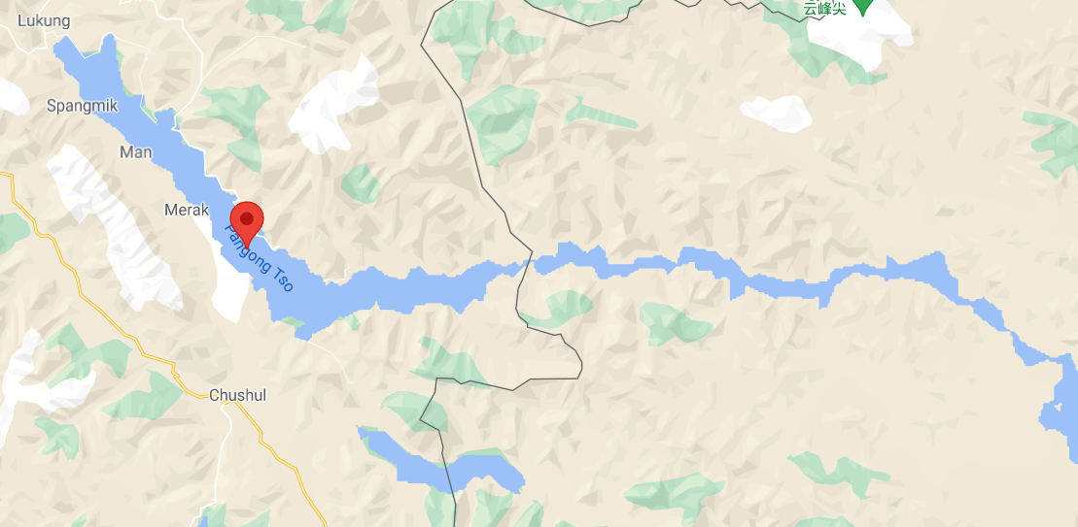
Prospective implementation requirements (if any)
This system can be used to secure the major ports of India one by one and then can be connected to each other in different phases of the project.
This system can be effectively used for monitoring and controlling the increased number of cases where the Chinese Army is caught trespassing into Indian side of Pangong Tso lake.

Slide 7
Conclusion
Looking at the benefits and the way, the government of India is promoting Digital campaigns, Smart Tag can be the solution to the traditional system of tracing and collecting tolls from the vessels that enter the Exclusive Economic Zone of India.
The security of the water bodies around the Indian landmass can be increased by manifolds, thus reducing the risk of any future attack.
The overall cost of this system is Rs. 37,000 for the electromagnetic readers and maximum Rs. 1200 for tags we use.

